Slide 1
INTRODUCTION TO SEARCHING FOR INFORMATION ON THE INTERNET

Slide 2
CONTENT
Common Terminologies
Information Available on the Internet
Challenges of Searching on the Internet
Steps/Techniques for Searching on the Internet
Methods of Searching
Using the Boolean Operators
Illustration

Slide 3
COMMON TERMINOLOGIES
Internet A worldwide network of computers that are connected by telephone lines and fiber-optic cables. It allows people all across the world to communicate with each other instantaneously, and has revolutionized how we share and access information
A network of the interlinked computer networking worldwide, which is accessible to the general public. These interconnected computers work by transmitting data through a special type of packet switching which is known as the IP or the internet protocol.
A global network of computers linked together, accessible mainly via the World Wide Web

Slide 4
COMMON TERMINOLOGIES- CONT’D
URL URL stands for Uniform Resource Locator. It is the address of a web page. It represents a unique location or "address" of a resource located on the World Wide Web. Each page has its own unique web address (URL). This is how your computer locates the web page that you are trying to find.
Parts of the URL eg.
http://www.starwars.com/seminars.html
http:// - hypertext transfer protocol:
the language computers use to “talk” to one another

Slide 5
COMMON TERMINOLOGIES- CONT’D
www—world wide web:
the body of information connected by the cables and computers of the Internet
starwars—domain name:
the structured, alphabetic-based, unique name for a computer on a network
com—top level domain:
gives an idea of where the document is stored
/seminars—file name:
a folder within a website
html—hypertext markup language:
the computer language used to format documents

Slide 6
COMMON TERMINOLOGIES- CONT’D
Search Engine
Search engines are programs that search documents for specified keywords and return a list of documents in which the keywords were found.
PDF (Portable Document Format) It is a file format that retains a document's true formatting across platforms. In plain language, it is a file that will look the same on the screen and in print, regardless of what kind of computer or printer someone is using and regardless of what software package was originally used to create it.

Slide 7
COMMON TERMINOLOGIES- CONT’D
They also contain the complete formatting of the original document, including fonts and images, PDF files are highly compressed, allowing complex information to be downloaded efficiently
HTML Stands for Hypertext Markup Language. It is used to create Web pages. That is, Web pages all over the world consist of HTML. It is the publishing language of the World Wide Web

Slide 8
COMMON TERMINOLOGIES- CONT’D
DOI
DOI (Digital Object Identifiers) numbers are unique number combinations assigned to an article. With the help of this DOI number the article can always be located.
Example: doi:10.1016/j.fertnstert.2004.08.029 - The numbers consist of-
-numbers assigned to the publisher (in the example above, these are 10.1016)
-the journal title (j.fertnstert or the Journal of Fertility and Sterility)
-some numbers that define the actual article
Hyperlink
A page on the Web where you can find additional information by clicking

Slide 9
COMMON TERMINOLOGIES- CONT’D
Search Query Words that are typed into a search engine in order to get information from the internet. It can also be a question or an inquiry. To look for information contained in a database by entering words or numbers in a search box.
Hits The results of your search as you enter in your query. The search results are usually presented in an order or sorted by a criteria eg. by year, author, relevance, publisher, subject etc.
Recall and Precision Recall is the ratio of the number of relevant records retrieved to the total number of relevant records in the database. It is usually expressed as a percentage.
Precision is the ratio of the number of relevant records retrieved to the total number of irrelevant and relevant records retrieved. It is usually expressed as a percentage.

Slide 10
COMMON TERMINOLOGIES-
Illustrating Recall andPrecision
John conducted a search on the query “poverty alleviation” and retrieved 80 hits. Out of this number 45 of the hits answered his query, but the rest did not. Meanwhile there were 5 other records in the database which the search could not retrieve but relevant to the information he needed.
State how many-
relevant records were retrieved.
irrelevant records were retrieved.
relevant records were not retrieved.

Slide 11
COMMON TERMINOLOGIES-
Illustrating Recall andPrecision- Contd
2. Calculate
the recall of his search
the precision of his search

Slide 12
COMMON TERMINOLOGIES- CONT’D
Abstract A brief summary of the points in an article. It can also be a source that compiles, by subject, author or title articles in a selected group of periodicals and includes a summary of each article.
Article A contribution written for publication in a journal, magazine, or newspaper.
Citation A citation is a reference or footnote to an item (such as a book or periodical article); a citation contains the author, title, date of publication, and any other information needed to locate the item.

Slide 13
COMMON TERMINOLOGIES- CONT’D
Bibliography A list of citations or references to books or periodical articles on a particular topic. Bibliographies can appear at the end of a book, journal, or encyclopedia article, or in a separate publication.
Scholarly journal Also called academic journal can be often a peer-reviewed journal or non peer-reviewed journal. Includes original research articles, written by researchers and experts in a particular academic discipline.
Peer-reviewed journal Also known as scholarly journal, or academic journal, or refereed journal. Publishes only original research articles that are subjected to a rigorous evaluation through the peer-review process.

Slide 14
COMMON TERMINOLOGIES- CONT’D
Reviewed articles They discuss research previously published by others, rather than reporting new experimental results. They are a useful overview tool; they provide a summary of recent research on a particular subject. Review articles are not considered
Open Access (OA) Journals Journals that are freely available online - this term specifically refers to free scholarly journals.
IP Address or IP Number (Internet Protocol number or address). A unique number consisting of 4 parts separated by dots, e.g. 165.113.245.2
Every machine that is on the Internet has a unique IP address. If a machine does not have an IP number, it is not really on the Internet. Most machines also have one or more Domain Names that are easier for people to remember

Slide 15
INFORMATION AVAILABLE ON THE INTERNET
The World Wide Web (www) contains millions and millions of pages of information. The information includes -
Electronic journals (e-journals),
Internet discussion groups and
Electronic versions of existing print journals.
Digitized versions of primary sources of information – egs. personal letters, official government documents, treaties, photographs, etc.
Audio and videos.
Statistical data, such as demographic or social science data.

Slide 16
CHALLENGES OF SEARCHING
Looking for information on the internet can be a daunting task because of the following reasons:
The web lacks formal organization.
Information overload - This term normally refers to the presence of too much information. Some of the information are full of low quality content, noisy, unreliable and contradictory data. Identifying content of good quality information out of the lot sometimes becomes a challenge; hence the problem of how much a website can be trusted.
There's little or no quality control on the Internet.
Practically anyone can place a site on the Web. Ease of uploading combined with relative anonymity increases the numbers of untruths and non-expertise sites that may appear

Slide 17
CHALLENGES OF SEARCHING – CONT’D
Internet has no standard indexing system
No “direct” searching of other computers - access to search tools only
Search tools search is limited
Information on the Internet is driven by machines called “spiders”, which come along with their own limitations.
Other challenges are
Access to internet facilities - Two major sources of Internet access provision have been identified as institutional provisions, private (home-based) Internet access and/or public facilities such as cyber cafes. According to researchers, Institutional provisions are far lower and the public facilities are also expensive to access.
Unavailability of computers or few computers found in our computer labs -

Slide 18
CHALLENGES OF SEARCHING – CONT’D
Irregular power supply endangering internet connectivity and service quality.
Unavailability of the information a user might be searching for.
Poor knowledge of the availability of sources to consult for the searches.

Slide 19
STEPS/TECHNIQUES FOR SEARCHING ON THE INTERNET
1. Define or determine your information need
  what sort of information are you looking for?
  what is the scope and depth of the information you need?
  who is going to use this information?
2. Choose your search terms
  analyze your topic
  identify unique words, key phrases, main concepts.
  look out for synonyms, alternate spelling, plurals, capitals, acronyms in the search terms
  consider broader or narrow terms or topics
3. Decide which sources to use
  gateways, databases, catalogues
  journals or books
  reference resources - e.g. encyclopaedias, dictionaries
  grey literature - e.g. governmental
  organizations publications, websites
  Find out how the search tool functions (as they vary somewhat)

Slide 20
CONTINUATION OF STEPS/TECHNIQUES FOR SEARCHING ON THE INTERNET –CONT’D
4. Find out how the search tool functions (as they vary somewhat)
  While databases may have certain search features common, they can also differ in some respects. To conduct a search therefore one has to take into consideration how the search tool in that particular database works or functions. You therefore proceed to run your search.
5. Run your search
  by using the terms/keywords and integrating synonyms, alternative spellings etc formulate search terms
  search terms are constructed by using the appropriate search operators eg. Boolean to combine keywords
  run your search in the sources you have selected
6. Review and refine your search
  be prepared to review/revise your search
  try new sources of information
  narrow or expand your search
  consult the HELP screens and read the "tips" files provided by most engines or try other search engines and databases

Slide 21
METHODS OF SEARCHES
1. Using Keywords – This type of searching is simply using specific terms or major themes in the topic to perform the search. Don't type an entire sentence into the search box. Think of the most important two or three words that deal with your topic. Remember, the more words you use, the fewer hits you will get, and vice-versa. Think of synonyms, related words, and broader and narrower terms. Think of all the words other people might use to talk about your topic.
For example, if a researcher is searching for information on “Measuring the impact of savings on the Financial performance of Banks”, he or She can use the keywords “savings”, Financial Performance” and “Banks” to retrieve relevant documents
2. Using a Phrase – A phrase allows users to search for documents containing an exact sentence. Many search engines allow users to perform an exact phrase search so that pages with only the words you typed in, in the exact order with no words in between them will be found. To perform an exact phrase search at a search engine that permits it, put the phrase in quotation marks. Examples are “Child labour”, Management Information Systems” and many more.

Slide 22
METHODS OF SEARCHES – CONT’D
3. Using Boolean Operators –
They are words such as AND, OR, and NOT that can be used to combine search terms especially when there is more than one search terms. This is called a Boolean search.
They are used to expand or limit your search. Expanding means you will get more articles, and limiting means you will get fewer articles.
Boolean operators help to define and focus the scope of the search.

Slide 23
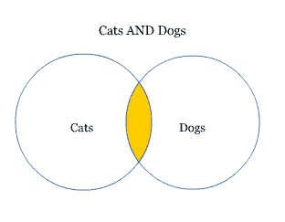
USING BOOLEAN OPERATORS- EXAMPLES
AND
An AND search says, find me articles that contain both of my search terms. Searches for cats AND dogs will retrieve articles that contain both the word "cats" and the word "dogs." If an article only contains the word "cats" but not the word "dogs", that article will not be retrieved.

Slide 24
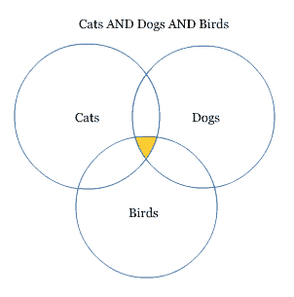
USING BOOLEAN OPERATORS- EXAMPLES CONT’D
AND – cont’d
You can combine as many search terms as you like, but it will limit your results even further. A search for cats AND dogs AND birds will only bring up articles that mention all three

Slide 25
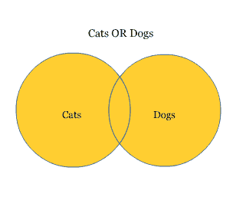
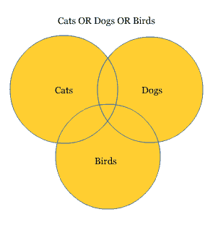
USING BOOLEAN OPERATORS- EXAMPLES CONT’D
OR
An OR search says, "find me anything that mentions either this term or that term." Searches for cats OR dogs will retrieve all the articles that contain the word "cats", the word "dogs", or both. You can also add more search terms into the mix, with the understanding that this will further expand your search.

Slide 26
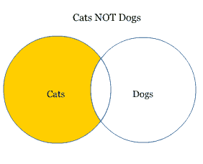
USING BOOLEAN OPERATORS- EXAMPLES CONT’D
NOT
A NOT search says, "find me anything that mentions this term but not that one."
Searches for cats NOT dogs will retrieve all the articles that contain the word "cats", but excludes from that list anything that uses the word "dogs."

Slide 27
USING BOOLEAN OPERATORS- EXAMPLES CONT’D
NOT –cont’d
An example of when to use NOT might be when you're looking for articles about spam (the lunch meat) and you keep getting things about SPAM (the junk e-mail.) You could do a search like, spam NOT email.
NOTE: You have to be very careful when using this operator, as it will severely restrict your results and you may miss something important.

Slide 28
ILLUSTRATION
Topic: - The effect of body mass index on the fertility of women
Analysis of the topic
Consider the following
1. Keywords 2. Synonyms 3. Related/Broad/Narrow terms 4. Alternative spelling 5. Abbreviations 6. Singular/Plural

Slide 29
ILLUSTRATION- CONT’D
Key words
body mass index, fertility, women
Query: -“body mass index” AND fertility AND women
Expansion
1. Body mass index – overweight, underweight, obesity, bmi
2. Fertility – reproduction, sterility, infertility
3. Women – female

Slide 30
ILLUSTRATION – CONT’D
Nesting all terms to form one composite search term or query
Query: - (“body mass index” OR overweight OR underweight OR obesity OR bmi)
AND ( fertility OR reproduction OR sterility OR infertility)
AND (women OR females)

Slide 31
REFERENCES
http://www.kyvl.org/html/tutorial/research/howweb.shtml -
(http://www.library.illinois.edu/learn/intro/glossary.html)
(http://www.library.leiden.edu/education-research/library-research/open-access/what-is-a-doi.html)
(http://www.articlegarden.com/Article/Benefits-and-Drawbacks-of-the-Internet-as-a-Research-Source/5346)

